Slide 1

IT Insight - DBMS
By,
Anil Kumar
Assistant Professor, Dept. of ISE, CIT, Gubbi

Slide 2

Information Technology?
IT stands for Information Technology in context of computers. Information Technology uses computers and software to manage information.
Information Technology deals with electronic computers and computer software to store, process, convert, protect, transmit and retrieve information securely.
In an organization, it includes all physical hardware, operating systems, databases, storage and servers etc.

Slide 3
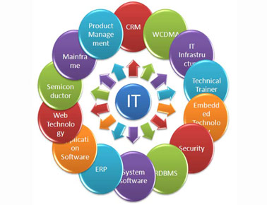
Fields of Information Technology
Software Development
Software design
Web development
Database design
Data management
Information security
Networking
Web design

Slide 4
Designations in the IT sector
Software Developers
Network Engineers
Database Administrator
Computer Programmer
Computer Scientists

Slide 5
7 Reasons Why IT is the Best Industry for Job Hunters
7. Increased availability of IT Jobs
6. Increasing technological advances
5. Expand your mind
4. IT jobs will motivate you to be your best
3. Make new friends
2. Work hard, play hard
1. Show me the money

Slide 6
5 Programming Skills Every Business and Programmer Needs
Python
Java
SQL
C++
C

Slide 7
Usage of different languages in IT Industries
Front-end web development: JavaScript, HTML
Back-end web development: JavaScript, Java, Python, PHP, Ruby
Mobile development: Swift, Java, C#
Game development: C++, C#
Desktop applications: Java, C++, Python
Systems programming: C, Rust

Slide 8

Most Important IT Skills Employers Look For

Slide 9
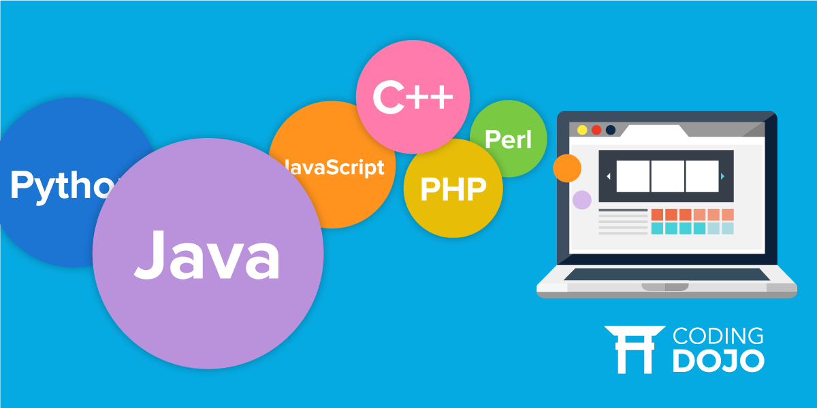
Job posting contain top languages

Slide 10
Trends in Database Management
Databases that bridge SQL/NoSQL
Databases in the cloud/Platform as a Service
Automated management
An increased focus on security
Big Data

Slide 11
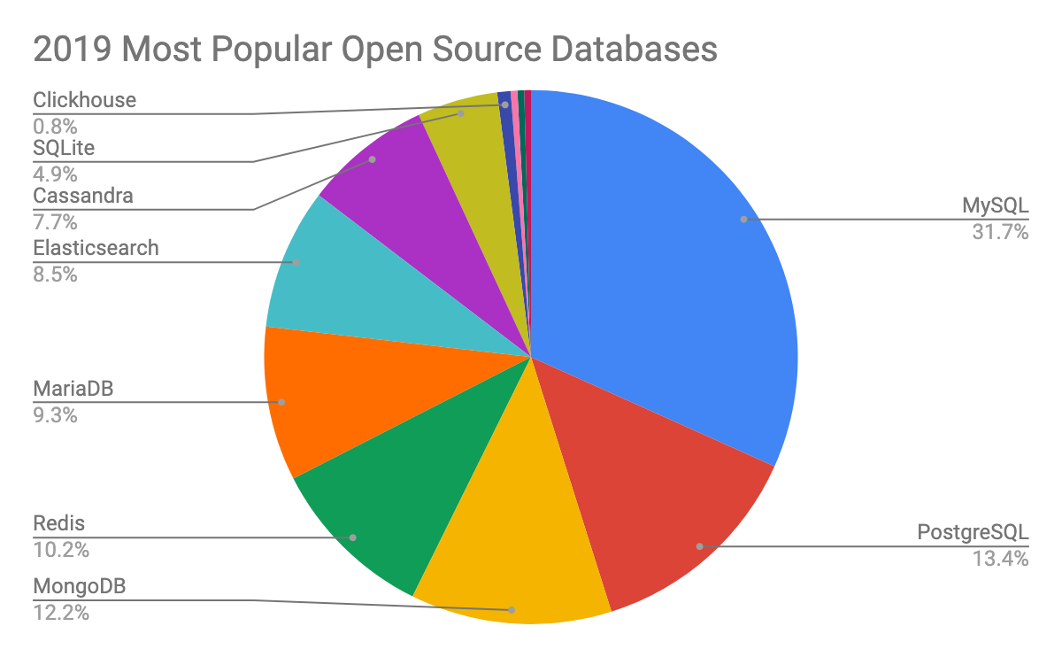

Slide 12
Three ways to gain clarity on the best career for you
3. Take action
2. Seek out jobs that you didn’t know existed
1. Do SELF AUDIT

Slide 13
Placement Activity Plans
Database Introduction
SQL Code Play Android Application
Basic SQL and Execution
Advance SQL and Execution
MCQ Company Based question
Database Application development using JAVA

